Slide 1
Genes and Mutations

Slide 2
What are we doing today?
Different genotypes produce a variety of phenotypes, which are acted on differently by factors in the environment, producing different rates of survival (SU)
Mutations are the ultimate source of variation introducing new alleles into a population: new alleles may be favourable or unfavourable to survival (SU)
Mutations in genes and chromosomes can result from errors in DNA replication, cell division or from damage caused by mutagens (SU)

Slide 3


Genes
DNA
Gene
Protein
Trait

Slide 4
Genotypes and Phenotypes
Genotypes: Genetic sequence/alleles
Phenotype: Visible characterises

Slide 5
Mutations
Variations in phenotype that do not resemble parents or family history.
Occur suddenly or by chance
Due to change in genetic material

Slide 6
Mutagens
Increase the rate at which mutations occur.
For example;
X-rays
Radioactive fallout
Mustard gas
Formaldahyde
UV light

Slide 7
Types of mutations
Gene: changes in single genes
Chromosomal: changes in all or part of chromosome
Somatic: Occurs in body cells
Germline/Germinal: Occurs in reproductive cells

Slide 8
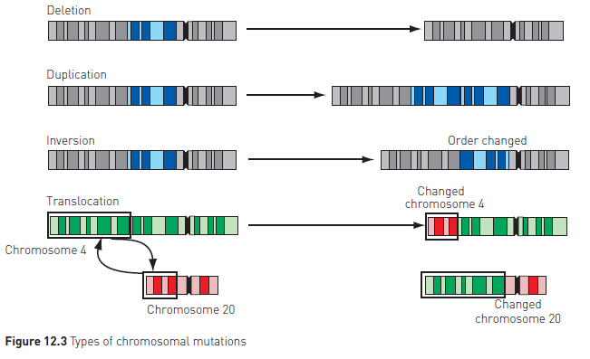
How do mutations occur
Gene mutations: Occurs during DNA replication before cell division. Normally mistakes are corrected but if not, hen the cell divides, it copies the mistake.
Chromosomal mutations:
Depletion: part of chromosome is lost
Duplication: part of chromosome occurs twice
Inversion: breaks occur in the chromosome, and broken parts join in the wrong way round.
Translocation: break occurs in chromosome and broken parts join the wrong chromosome
Non-disjunction: During meiosis, chromosome pair does not separate so one daughter cell has one extra chromosome and one daughter cell has one less chromosome.

Slide 9
Effects of mutations
Albinism
Duchenne dystrophy
Cystic fibrosis
Haemophilia
Sickle cell anaemia
Tay-Sachs disease
Phenylketonuria

